Slide 1
Trainity Project 1
Instagram User Analytics

Slide 2
Brief overview of the project
Data about the users of Instagram app is provided.
In the data, tables like users, follows, comments, likes, tags, photos, photo_tags are present
Our role is to analyze the data and retrieve important insights through the tables present in the database which could be used for the betterment of the business and the insights can also be used for the development of the instagram application.
For the retrieval of data, we are going to use SQL workbench because of the following reasons:
It allows you to obtain results very quickly.
Codes can be optimized to obtain results quickly.
Data integrity is ensured.
It can analyze multiple tables at once.

Slide 3
Marketing Analysis:
Loyal User Reward: The marketing team wants to reward the most loyal users, i.e., those who have been using the platform for the longest time.
Your Task: Identify the five oldest users on Instagram from the provided database.
Approach: Firstly tables were studied carefully and the table which could be used for the retrieval of the data was chosen i.e Users table
Users table consisted of id, username and created_by column. Since we had to find the oldest users on Instagram, so order by function was used on created by column and limit function was used for obtaining the top five oldest users on Instagram.

Slide 4
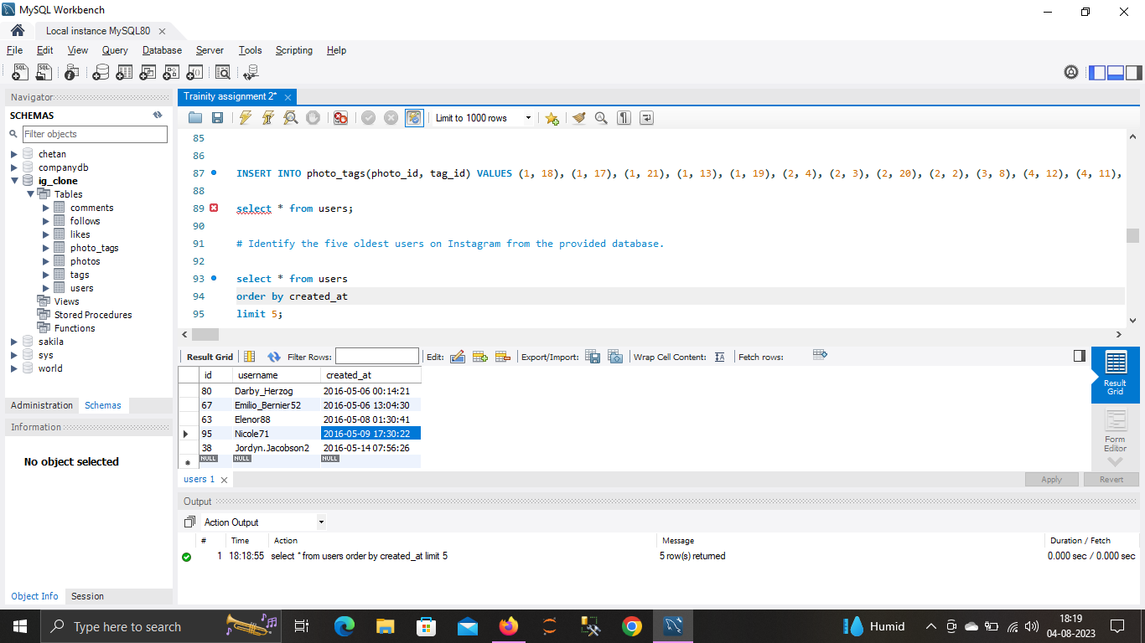
Code and Output of the code :

Slide 5
Inactive User Engagement: The team wants to encourage inactive users to start posting by sending them promotional emails.
Your Task: Identify users who have never posted a single photo on Instagram.
Approach: To obtain the name of all the users who have never posted a single photo on Instagram, it was necessary to retrieve the data from two tables i.e Users and Photos.
Left join was done on users and photos tables and where clause was used under the condition of is null because we needed to find the users who have null or zero count in photos_uploaded column.
Hence, total 26 users were on the list who never uploaded the photos on instagram.

Slide 6
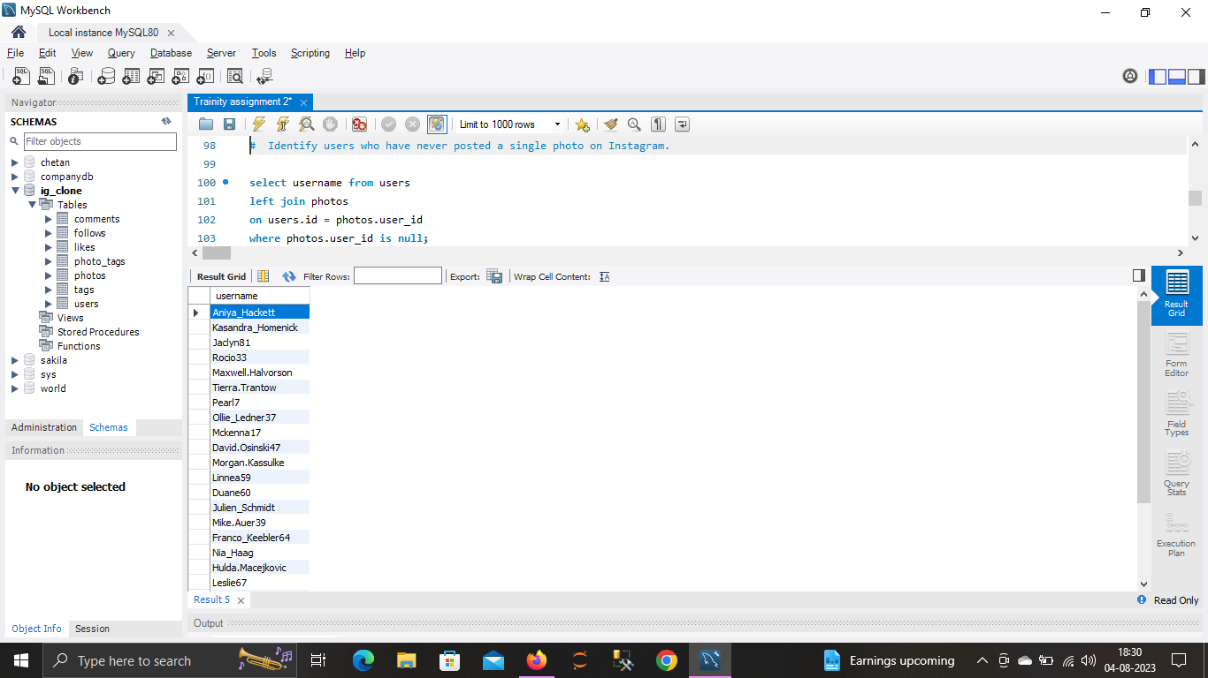
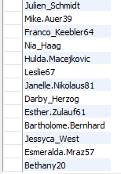
Code and Output of the code :

Slide 7
Contest Winner Declaration: The team has organized a contest where the user with the most likes on a single photo wins.
Your Task: Determine the winner of the contest and provide their details to the team.
Approach: To obtain the name of the user who has most likes on a single photo on Instagram, it was necessary to retrieve the data from three tables i.e Users, photos and likes.
We can obtain the name of the winner from users table, photos uploaded by the respective users from the photos table and likes obtained on single photo can be obtained from likes table.
Join is used between photos and likes and then between users and photos column, since we need the count of likes on each photos hence group by is used photo.id and the users having maximum count of likes on the photo is retrieved from the data.
Hence, total 3 users were on the list who got the maximum no. of likes on their respective uploaded photos

Slide 8
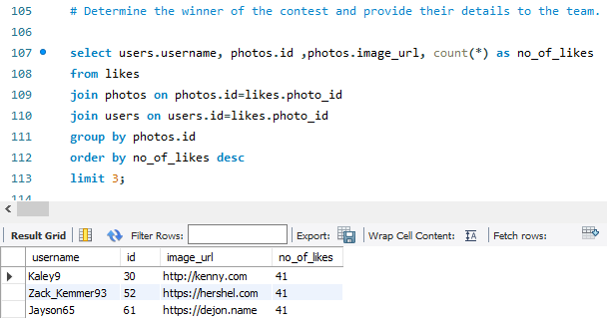
Code and Output of the code :

Slide 9
Hashtag Research: A partner brand wants to know the most popular hashtags to use in their posts to reach the most people.
Your Task: Identify and suggest the top five most commonly used hashtags on the platform.
Approach : To obtain the top five commonly used hashtags, we will need tags and photos_tag table.
Since we need the count of the hashtags, we firstly use inner join between photo_tags and tags table and then used group by on tag_name which will eventually provide the count on all the hashtags and to obtain the highest count first, we use order by on count on descending order and then limit the list to 5

Slide 10
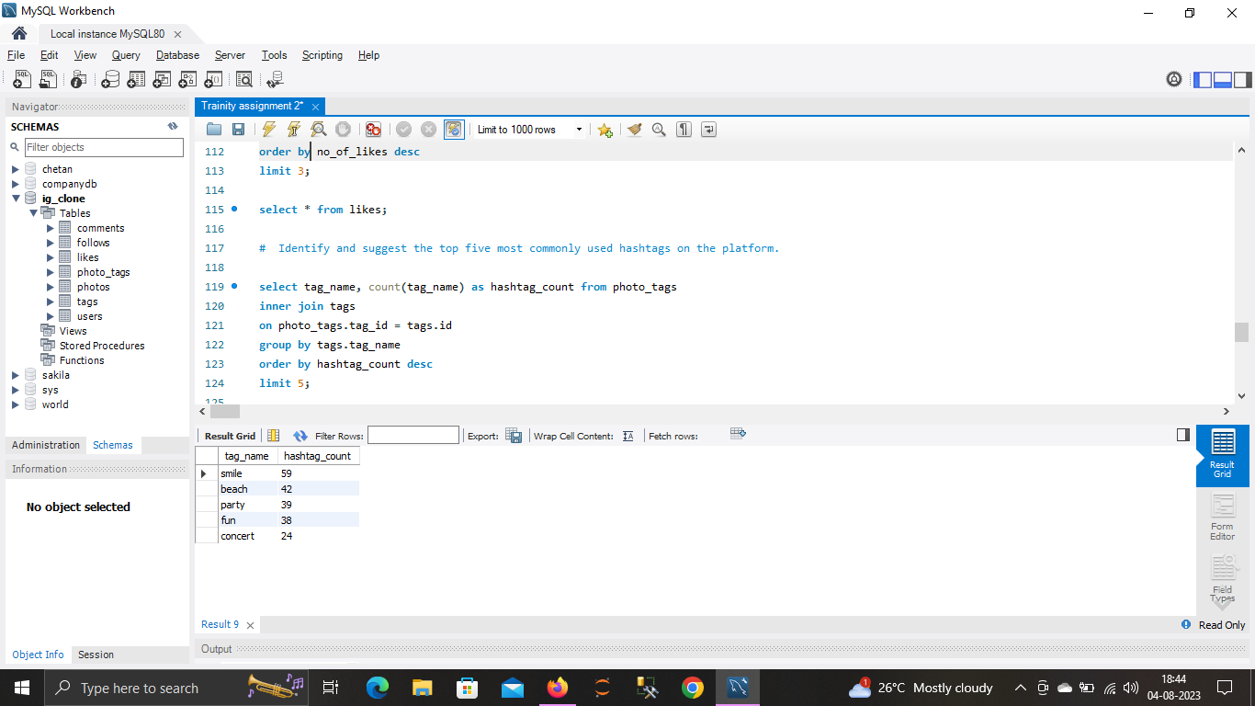
Code and Output of the code :

Slide 11
Ad Campaign Launch: The team wants to know the best day of the week to launch ads.
Your Task: Determine the day of the week when most users register on Instagram. Provide insights on when to schedule an ad campaign.
Approach : To determine the day of week when most users register, we firstly need to retrieve the week value from the date format given in the created at column in users table.
Since we need to count of the registrations hence we use group by on week and then can the order using the count and make it in descending order.
From the results, it can seen clearly that the maximum registrations are been carried out on Thursdays and Sundays. Hence, the ad campaign must be done on Sundays, because many users have weekly holidays on Sundays. Hence, It would much more profitable to lunch a ad campaign on Sundays than on Thursdays.

Slide 12
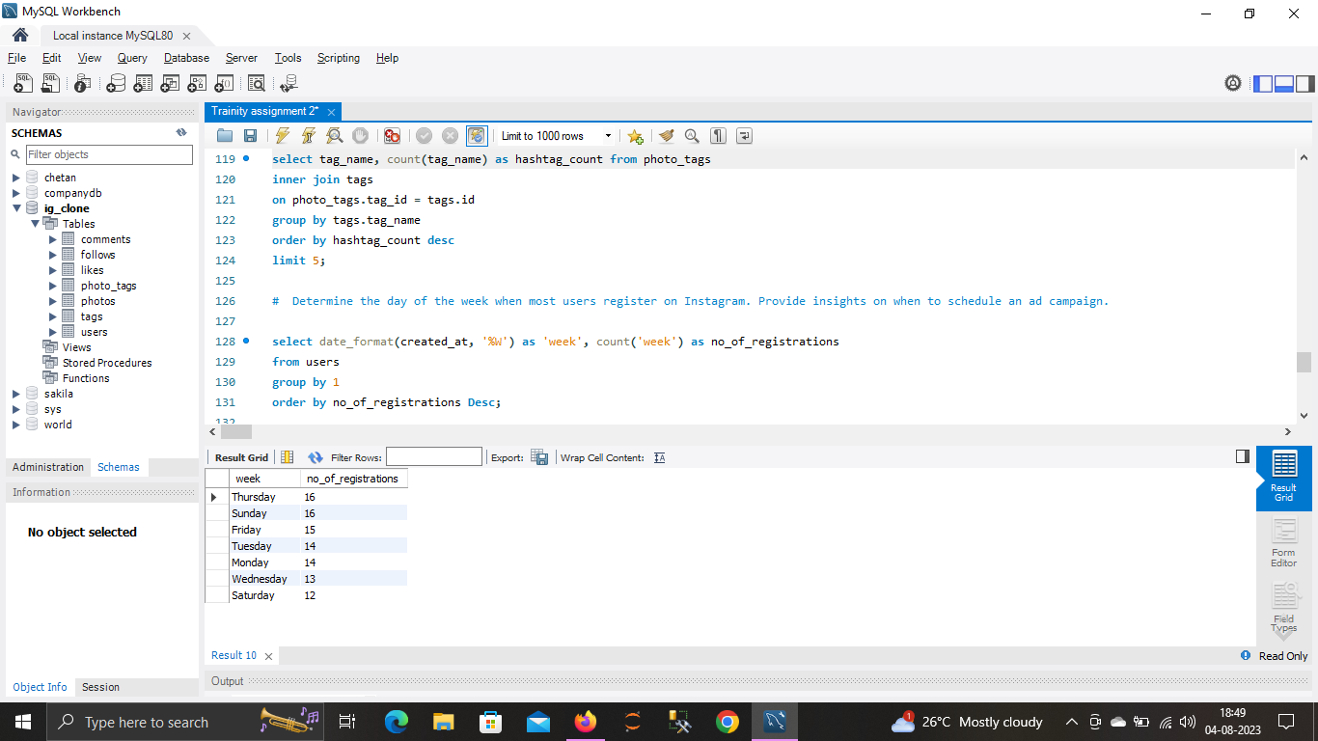
Code and Output of the code :

Slide 13
Investor Metrics:
User Engagement: Investors want to know if users are still active and posting on Instagram or if they are making fewer posts.
Your Task: Calculate the average number of posts per user on Instagram. Also, provide the total number of photos on Instagram divided by the total number of users.
Approach : Since average of post per user is need to obtained, hence firstly count of users and photos is done respectively, and then arithmetic function divide (‘/’) is used on both the counts to obtain the value. Since the value is in float type, hence round was used while using the arithmetic function to obtain the float value restricting it to three values after decimal point.

Slide 14
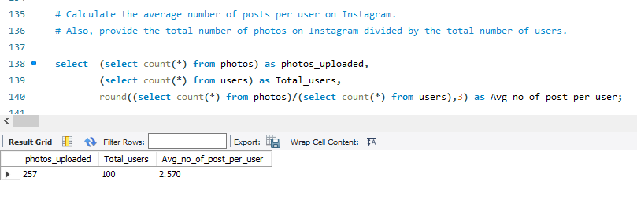
Code and Output of the code :

Slide 15
Bots & Fake Accounts: Investors want to know if the platform is crowded with fake and dummy accounts.
Your Task: Identify users (potential bots) who have liked every single photo on the site, as this is not typically possible for a normal user.
Approach : To obtain the list of users who have liked all the photos uploaded on instagram, we use tables like users and likes.
Using join function on users and likes table.Since we need the count of likes on respective users, we use group by on the username from users table.
Since, we know that there are total 257 photos uploaded, hence we try to find the users who have a total likes of 257.
Total, 13 user profiles were obtained who have liked all the photos and can be potential bots.

Slide 16
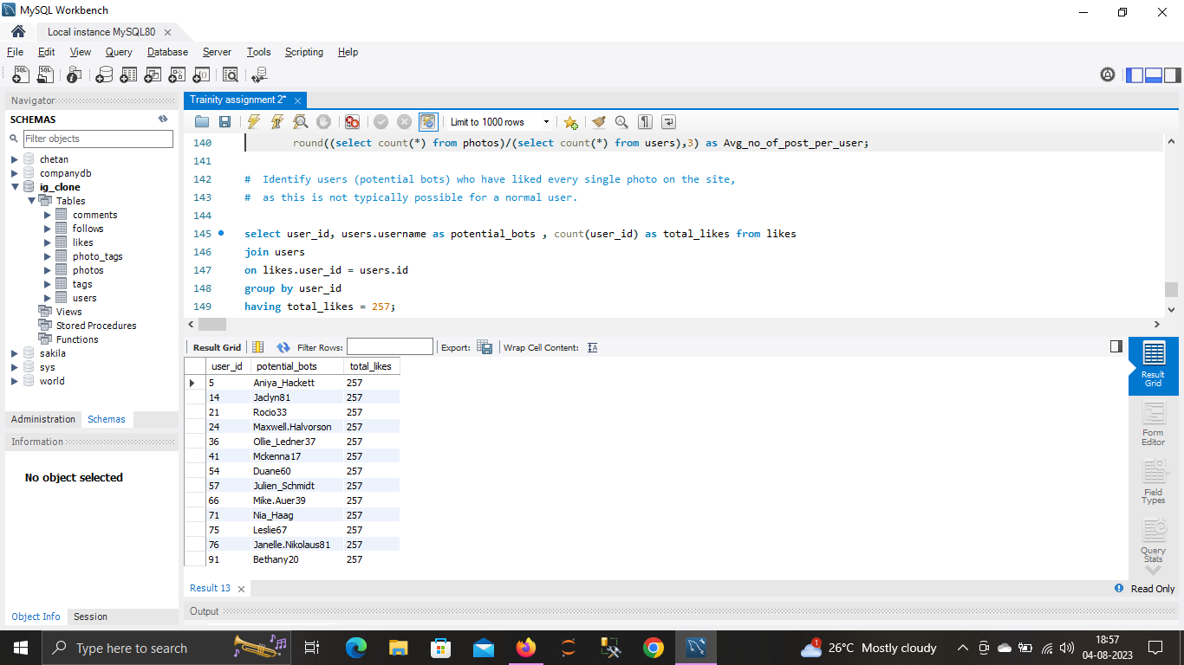
Code and Output of the code :

Slide 17
Result :
Through this project, got to handle multiple tables in a single database.
Got a knowledge of how data is present in real-life world.
Since the project consisted of multiple tables, hence got to study the link between the tables i.e how the tables are related with each other.
Got to practice more on joins and other functions like Groupby and orderby.
Got a clear understanding on how to join multiple tables to retrieve the required data.
Because of the project, feeling pretty confident now to use SQL workbench.

